Slide 1

Control Flow
Notes:
[0:30;0-1]
Hello guys and welcome.
Today, we focus on commands that allow us control the flow of our program.
Firstly, I should introduce myself for you to know who I am.

Slide 2

Ondra
Notes:
[1:0; 1-2]
So this is (or was) me. Can you recognize me?
I’m an assistant professor at Czech Technical University in Prague, Czech Republic. And I am also a CS bridge lecturer for second year.
I love teaching computer science.

Slide 3
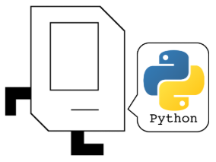
Notes:
[1:0; 2-3]
Enough about me. Let’s focus on the superstar of today: Karel.
Karel is a robot. Karel speaks Python. We tell Karel what to do.
Did you know that Karel is named by Czech writer Karel Čapek, who first used the word ROBOT?

Slide 4
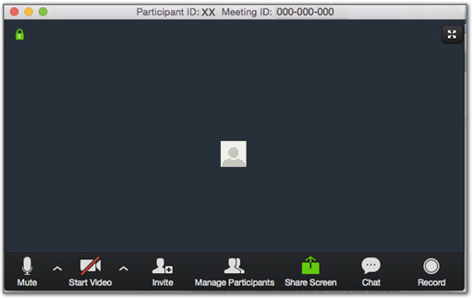
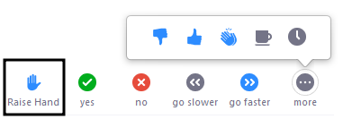

Notes:
[3:0; 3-6]
interactions
do interact, ask questions
chat
our assistant, say hello
speak: raise hand
other icons
stay muted

Slide 5


“Streets” run East/West
North
3
+
+
+
+
+
“Avenues” run North/South
2
+
+
+
+
+
West
East
1
+
+
+
+
+
South
Notes:
[1:0; 6-7]
Karel’s world
simple
fields, boundaries, obstacles, beepers
navigation

Slide 6

move
turnLeft
putBeeper
pickBeeper
Notes:
[1:; 7-8]
only 4 instructions.
still complex things

Slide 7
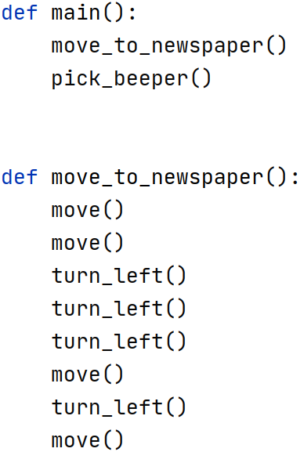
Notes:
[2:0; 8-10]
call Karel’s commands
define our own commands
indentation
calling our command means…
readable

Slide 8
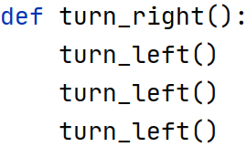
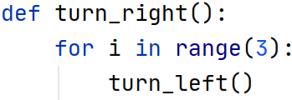
Notes:
[1:0 10-11]
repeating commands
indentation
readability

Slide 9
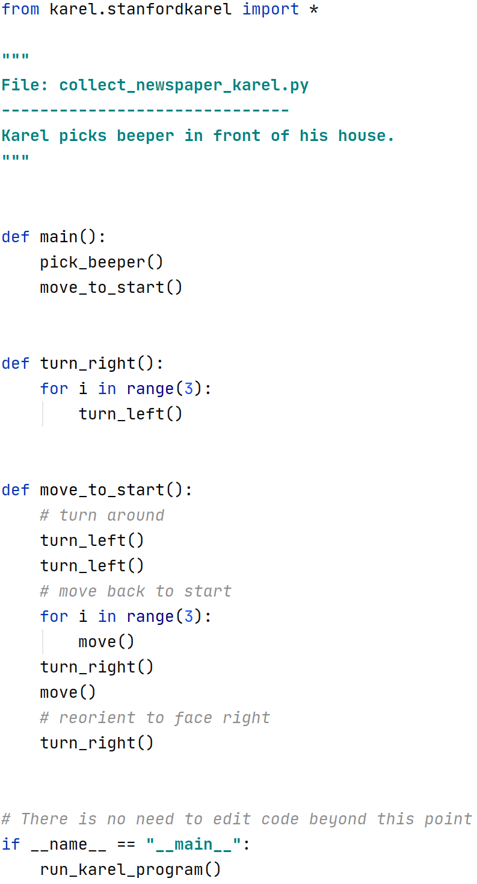
Multi-line comment
Main function
Our function
Single-line comment
Notes:
[2:30 11-14]
main function
other functions own commands
comments
first and few last lines

Slide 10
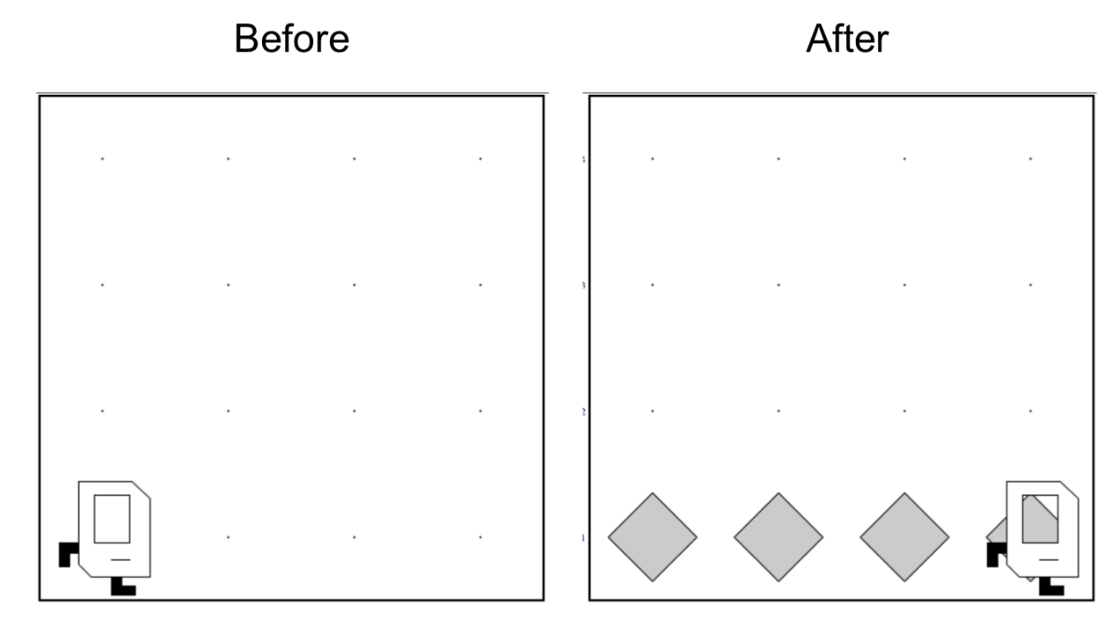
Put a line of beepers in a world of any size.
?
Notes:
[1:0 14-15]
unknown dimensions
beeper line

Slide 11
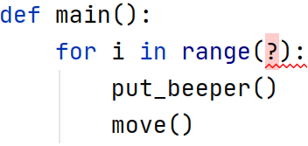
?
Notes:
[1:0; 15-16]
hit wall
leave empty field
need to ask, condition

Slide 12
Test | Opposite | What it checks
front_is_clear() | front_is_blocked() | Is there a wall in front of Karel?
left_is_clear() | left_is_blocked() | Is there a wall to Karel’s left?
right_is_clear() | right_is_blocked() | Is there a wall to Karel’s right?
beepers_present() | no_beepers_present() | Are there beepers on this corner?
beepers_in_bag() | no_beepers_in_bag() | Any there beepers in Karel’s bag?
facing_north() | not_facing_north() | Is Karel facing north?
facing_east() | not_facing_east() | Is Karel facing east?
facing_south() | not_facing_south() | Is Karel facing south?
facing_west() | not_facing_west() | Is Karel facing west?
Notes:
[1:0; 16-17]
we can ask these
simple questions with YES/NO answer

Slide 13
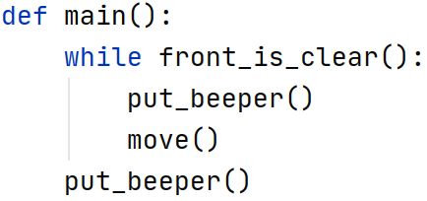
condition
body
indentation
command outside body
Notes:
[1:45; 17-19]
Meet the while loop.
evaluate a condition
YES/NO answer
is front clear?
YES: execute body and evaluate again
NO: skip body
indentation
it reads...

Slide 14
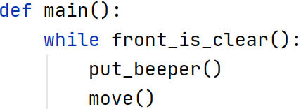
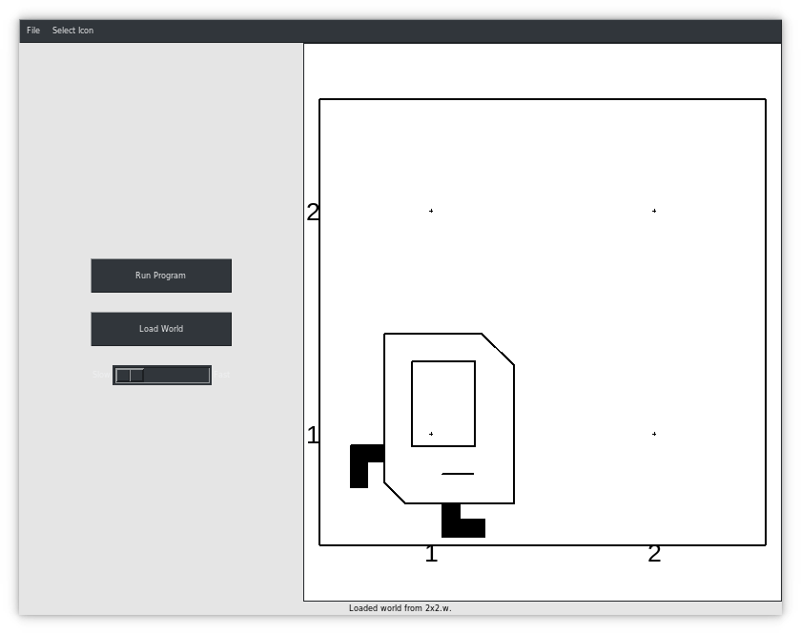
Notes:
[0:45 19-20]
trace the program
it is not correct, wait

Slide 15
Notes:
[0:45; 20-21]

Slide 16
YES
Notes:
[0:45; 20-21]

Slide 17
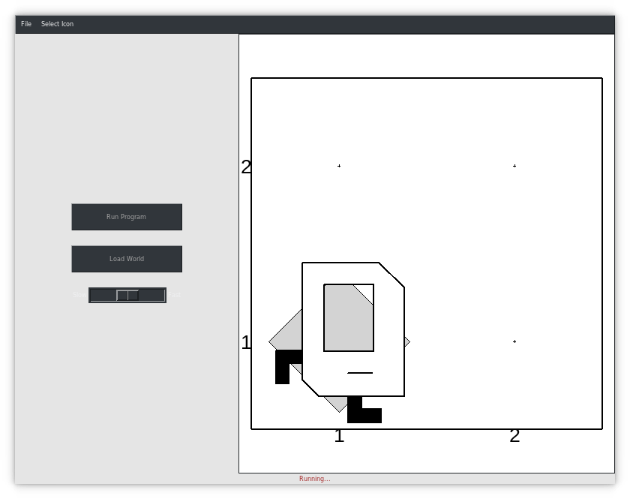
Notes:
[0:45; 20-21]

Slide 18
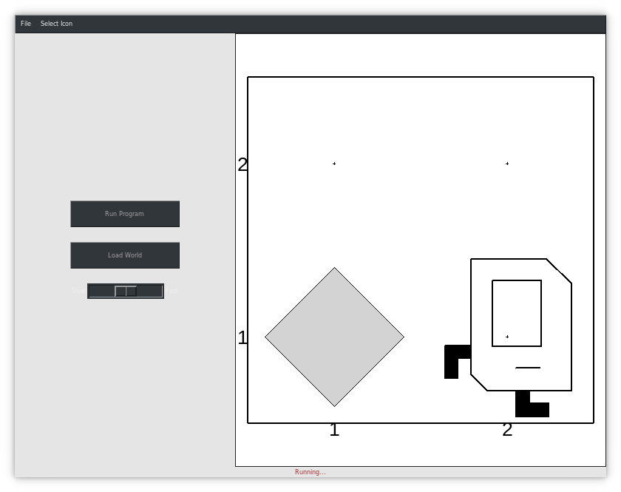
Notes:
[0:45; 20-21]

Slide 19
NO
Notes:
[0:45; 20-21]

Slide 20
Notes:
[0:45; 20-21]
The program ended like this.
not correct
NEXT

Slide 21
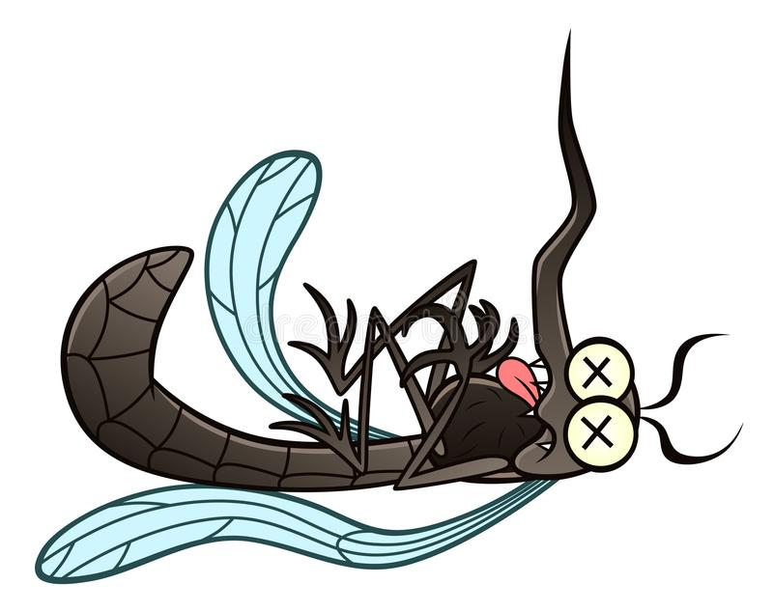
Notes:
[0:30 21-22]
bug
missing beeper

Slide 22
N beepers
N moves
N beepers
N−1 moves
Notes:
[1: 22-23]
do: N beepers, N moves, N=1
need: N beepers, N-1 moves, N=2

Slide 23
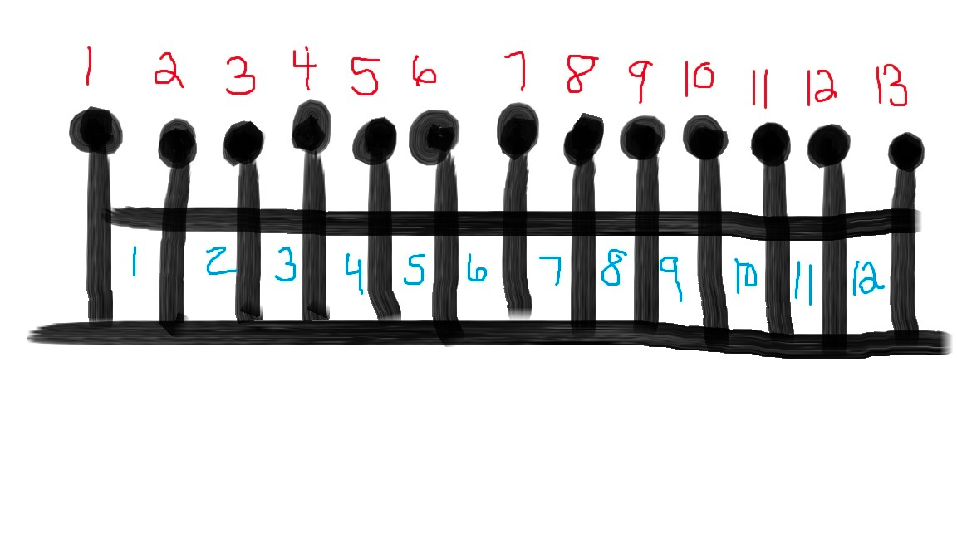
Fence Post Problem
Also sometimes called an “Off By One Error”
Notes:
[1: 23-24]
general programming problem
N posts, N-1 segments
N beepers, N-1 moves

Slide 24
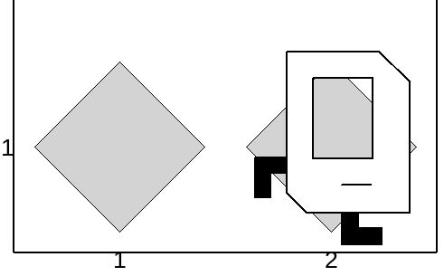
Happens N-1-times
Happens N-times (together)
Notes:
[1:30 24-26]
2 beepers vs. 1 move
Any questions about this?

Slide 25
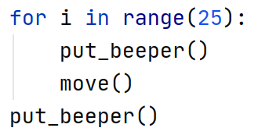
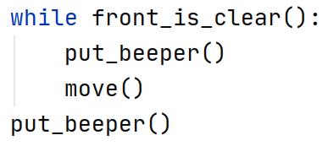
Notes:
[1:30; 26-28]
sum up
fixed number of repeats
vs.
depend on a condition

